Slide 1
GIT and GITHUB
School of Computing and Information Technology
R Rishabh Keeshan
rkkeeshan989@gmail.com
AY: 2020-2021

Slide 2
Outline
Difference between Git and GitHub
Why Version Controlling
Git – Version Control
Working of Git Repos
Demo on using GitHub

Slide 3
Git – Version Controlling

Slide 4
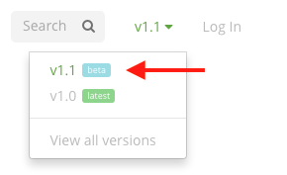
Versions and Version Control
Version is a particular release.
Updates to version can be Major or Minor.
Version control is a system that records changes to a file or set of files over time so that you can recall specific versions later

Slide 5
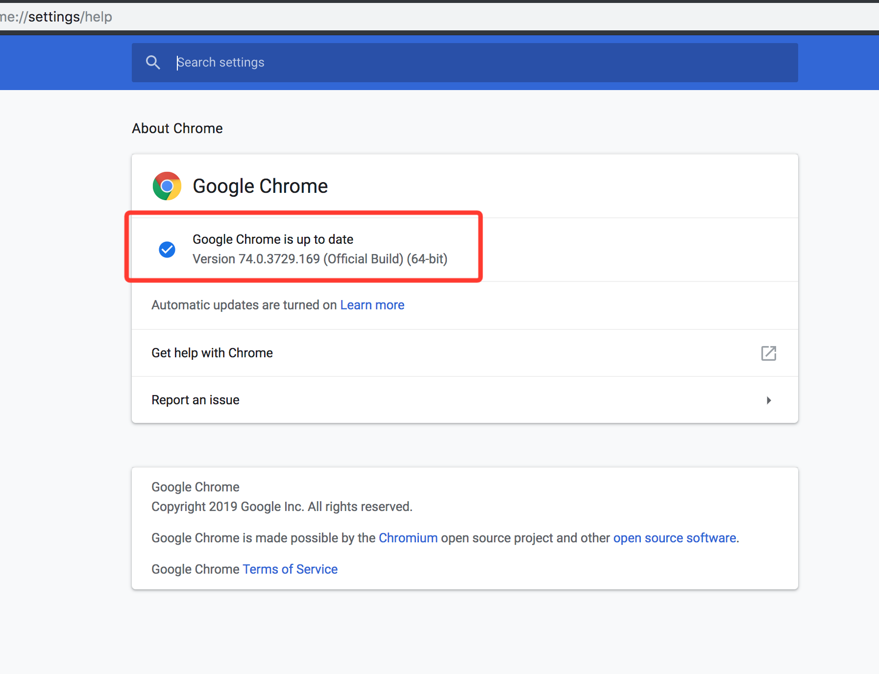
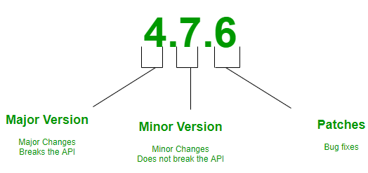
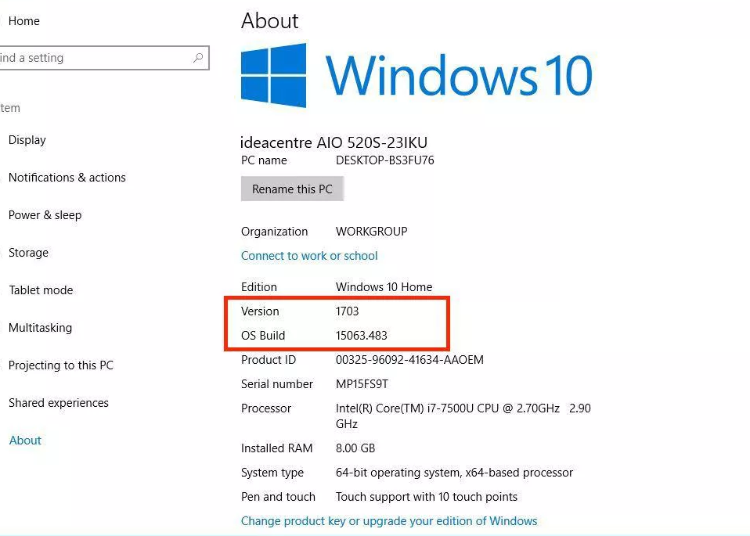

Slide 6

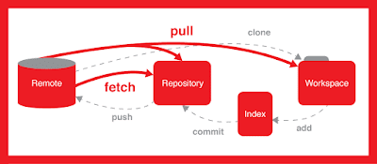
GIT
Free and Open Source
Distributed version-control system for tracking changes in source code during software development
Created on : C, Perl, Tool Command Language , Python
Command Line User Interface

Slide 7
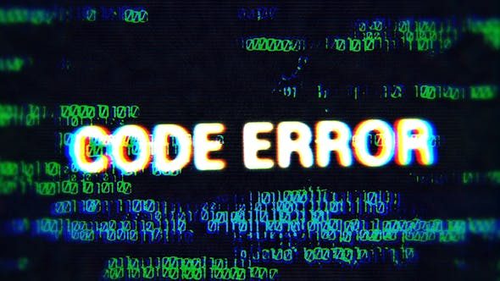
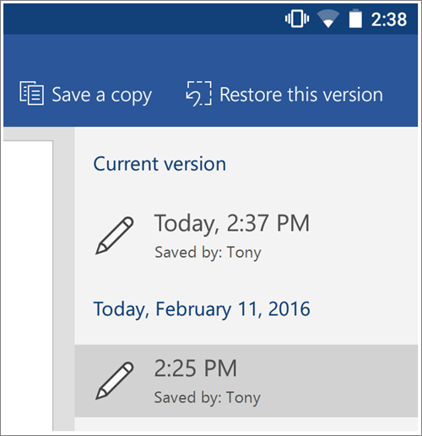
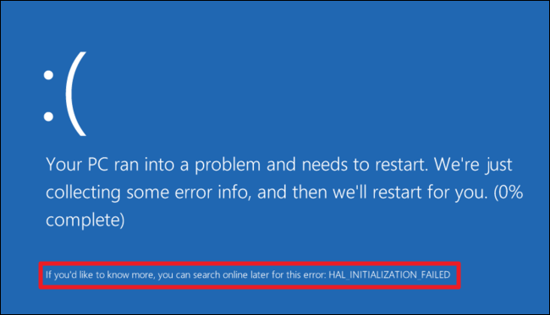
Why Version Control?
Tracking every individual change by each contributor.
Helping prevent concurrent work from conflicting.
Changes affecting existing Code

Slide 8
Difference between Git and GitHub

Slide 9
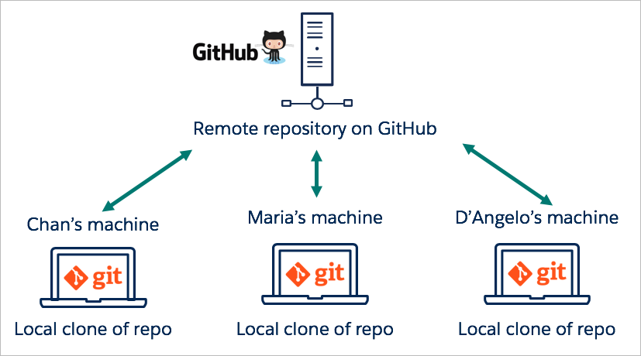

GitHub is a cloud-based hosting service that lets you manage Git repositories
Git is a version control system that lets you manage and keep track of your source code history

Slide 10
Git Repositories and their Working

Slide 11
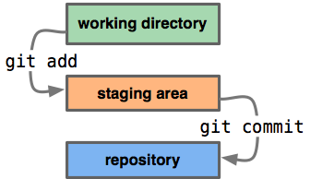

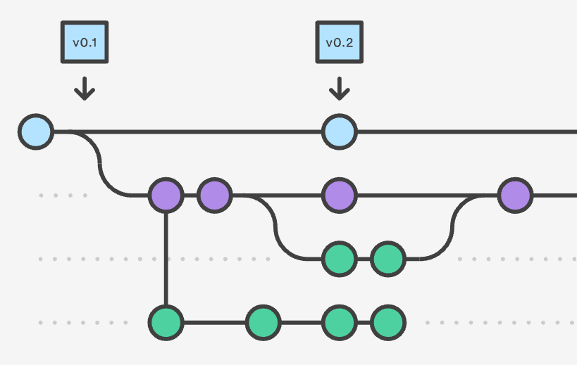
Some Important Terminologies
Repositories
Head
Stage Area or Index
Commit
Branch
Notes:
Software Testing Principle is a process of testing the result or output of a product with an expected output of a client or software testing is a process used to identify the correctness,competeness and quality of developed software.it include the set of activities conducted with the intent of finding errors in software so that it could be corrected before the product is released to the end user.

Slide 12
Notes:
Software Testing Principle is a process of testing the result or output of a product with an expected output of a client or software testing is a process used to identify the correctness,competeness and quality of developed software.it include the set of activities conducted with the intent of finding errors in software so that it could be corrected before the product is released to the end user.

Slide 13
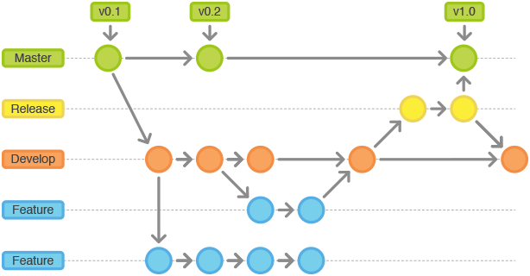
Notes:
Software Testing Principle is a process of testing the result or output of a product with an expected output of a client or software testing is a process used to identify the correctness,competeness and quality of developed software.it include the set of activities conducted with the intent of finding errors in software so that it could be corrected before the product is released to the end user.

Slide 14
Working with Git repositories on Github

Slide 15
Pre Requisites
GitHub Account
Git – Installed on system
https://git-scm.com/downloads
Git Desktop – For GUI
https://desktop.github.com/

Slide 16
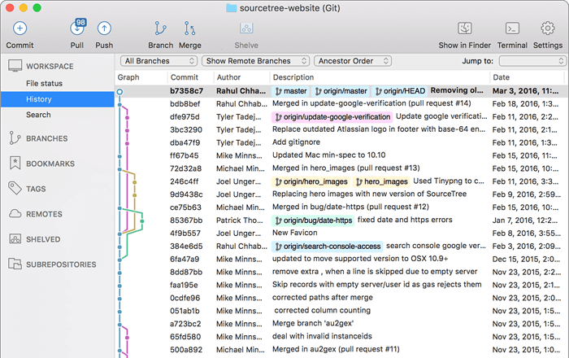
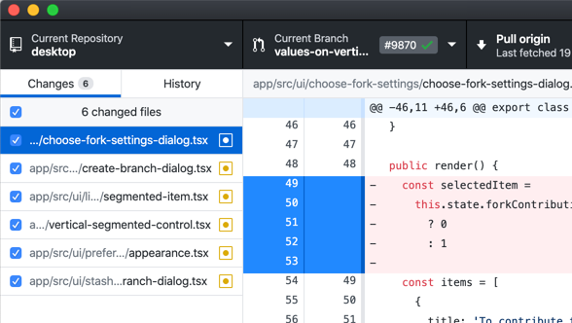
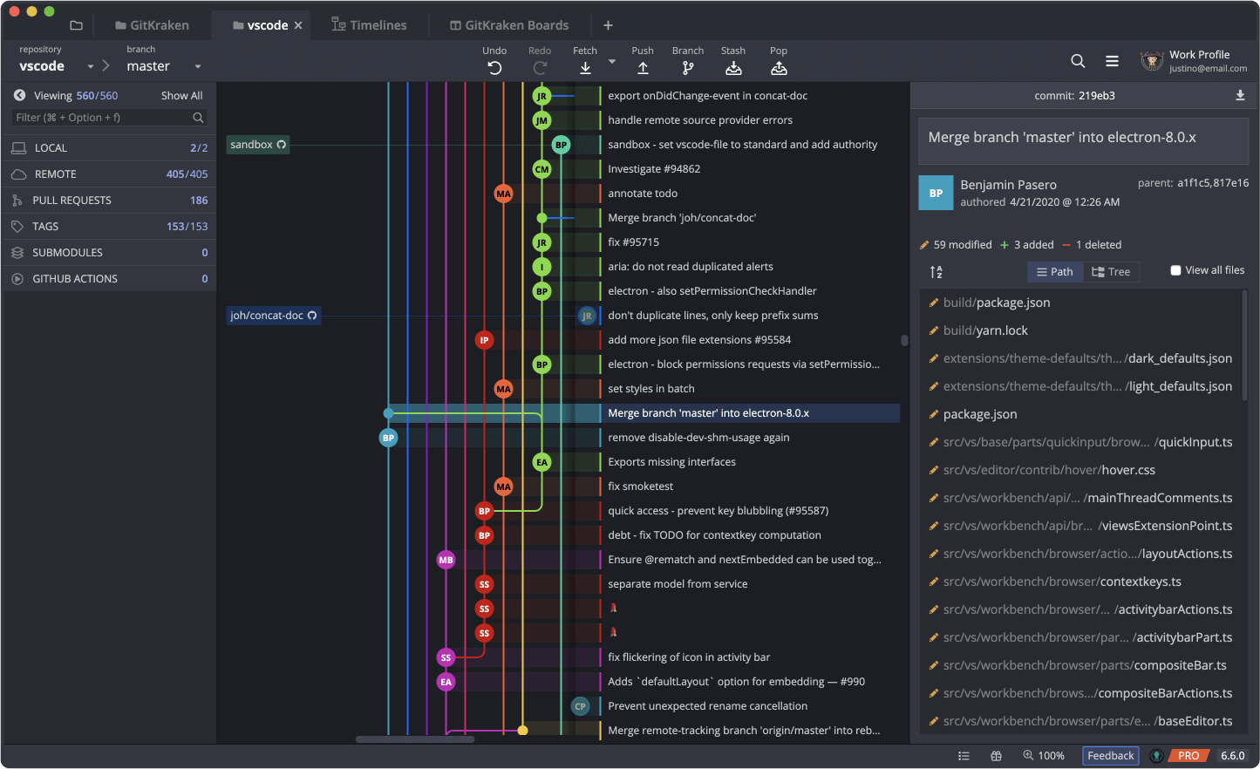
GIT GUI Software

Slide 17
Git Commands
git init – Initializing the repository in a folder Locally
git clone – clone a local or remote repository
git config – configure variables to link to your remote account
git config --global user.name <username>
git config --global user.email <registered email Id
git add – adding or staging files to the index
git add <filename>
git add *

Slide 18
git remote add <remote name> <remote url>
git checkout – change branch
git checkout –b <new branch name>
git checkout –d <existing branch name>
git checkout <branch name>
git push <remote> <branch>
git pull
git fetch
git merge <branch>

Slide 19
Reference for Git Commands:
https://rogerdudler.github.io/git-guide/

Slide 20
Thank You

